Slide 1
The
CUBAN
REVOLUTION
© Brain Wrinkles

Slide 2
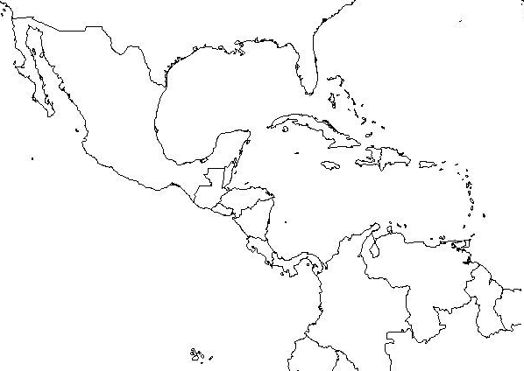
Where is Cuba?
© Brain Wrinkles

Slide 3
Cuba in the 1900s
Cuba gained its independence from Spain in 1898.
In the 1900s, Cuba’s wealth was controlled by American companies.
The main businesses in Cuba were sugar and mining companies.
The leader of Cuba was Fulgencio Batista.
© Brain Wrinkles

Slide 4
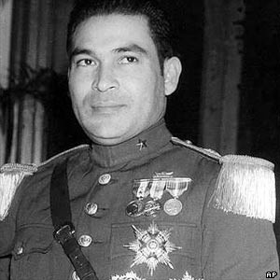
Fulgencio Batista
© Brain Wrinkles

Slide 5
Batista’s Cuba
Fulgencio Batista had originally been elected as president, but made himself dictator of Cuba.
Many people were unhappy with Batista’s rule.
Poverty was abundant, education was poor, and healthcare was limited.
© Brain Wrinkles

Slide 6
Social Unrest
Social and economic problems lead to the unrest of many Cubans.
There was a small class of rich Cubans with all the power, while the majority was very poor and had little to no power.
© Brain Wrinkles

Slide 7
Power to the People
Soon, revolutionaries lead by Fidel Castro began to rise up against the government.
Castro and his forces led an unsuccessful overthrow of the government in 1953, but began a full scale war against Batista’s government in 1955.
Castro attempted to overthrow Batista’s government for seven years.
© Brain Wrinkles

Slide 8
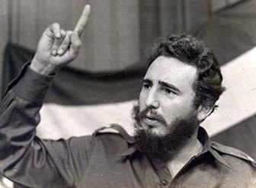
Fidel Castro
© Brain Wrinkles

Slide 9
Fidel Castro
Castro and his “army” lost many battles to Batista – he was even arrested and sentenced to 15 years in jail!
Castro was released in 1955 after serving only two years and fled to Mexico to put together a new group of rebel fighters.
By 1959, Castro and his men drove Batista and his supporters out of Havana, Cuba’s capital.
© Brain Wrinkles

Slide 10
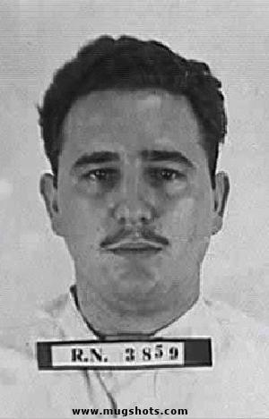
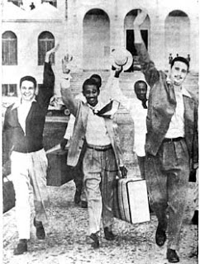
Fidel Castro Released from Prison
© Brain Wrinkles

Slide 11
Cuban Revolution
In 1959, Castro defeated the Batista government.
Castro seized absolute power and made himself dictator of Cuba.
He then had 700 of his enemies executed and many more were thrown in prison.
The US originally backed Castro and sent him supplies to defeat Batista because he promised to make Cuba a democracy.
© Brain Wrinkles

Slide 12
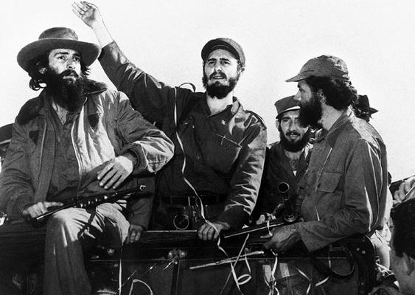
© Brain Wrinkles

Slide 13
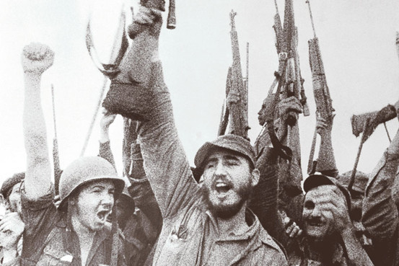
© Brain Wrinkles

Slide 14
Castro’s Promises
Fidel Castro promised to:
End American dominance over Cuban businesses,
Re-distribute the wealth evenly to all Cubans,
Make every Cuban literate,
and he wanted to give all Cubans healthcare and higher life expectancy.
© Brain Wrinkles

Slide 15
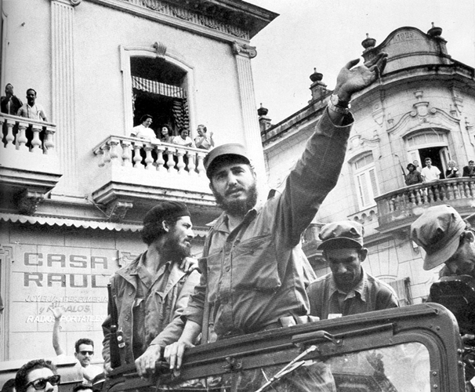
© Brain Wrinkles

Slide 16
Communism
Castro failed to do many of the things he promised he would do.
Castro began organizing a Communist government right away.
He declared that all property belonging to Americans now belonged to the Cuban government.
All farms, factories, & businesses now belonged to the government.
© Brain Wrinkles

Slide 17
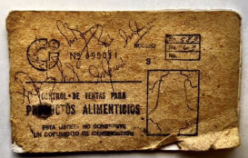
Communism
Cuban Supply Card
© Brain Wrinkles

Slide 18
Changes
Castro’s government gave less freedom to Cuba’s citizens.
Cubans no longer had the right to protest against the government.
Cuban newspapers, radio, & TV were shut down.
The government became the only source for news.
Churches were closed and property was taken over by government.
© Brain Wrinkles

Slide 19
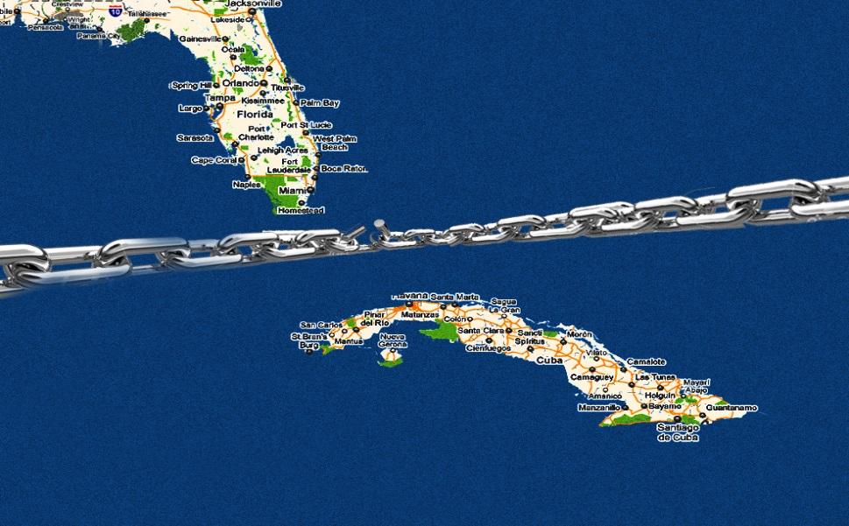
Breaking Ties
It was the ultimate goal of Fidel Castro to break ties between Cuba and the United States.
Americans who owned land and businesses in Cuba lost their property.
Castro forced American civilians to leave Cuba.
© Brain Wrinkles

Slide 20
Impact on US
After the revolution, relations between the American government and the Cuban government got worse and worse.
US did not like having a communist country so close.
US didn’t like Cuba having ties with the Soviet Union because they were involved in the Cold War.
© Brain Wrinkles

Slide 21
Cuban Missile Crisis
In October of 1962, US planes spotted secret Soviet missile bases in Cuba.
President Kennedy announced to US citizens that the Soviets had placed long-range missiles in Cuba.
This was an extremely TENSE time (height of the Cold War) that could have led to World War III.
© Brain Wrinkles

Slide 22
Resolution
President Kennedy agreed not to invade Cuba and to remove US missiles from Turkey.
In return, Khrushchev agreed to remove the missiles from Cuba.
© Brain Wrinkles

Slide 23
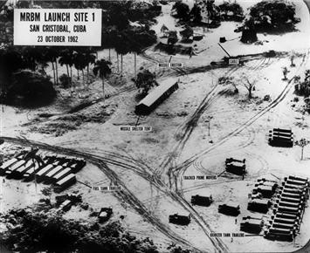
Missiles in Cuba
© Brain Wrinkles

Slide 24
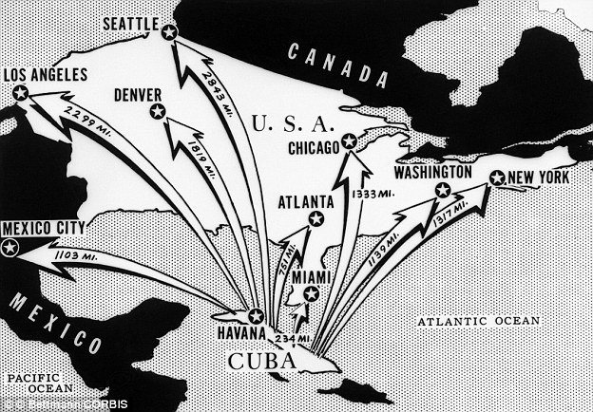
Missiles’ Range
© Brain Wrinkles

Slide 25
Embargo
Due to the harsh events, US placed an embargo on goods from Cuba in 1962.
Cuba’s sugar cane crop could no longer be sold in the US, which hurt Cuba’s economy.
As a result of the embargo, poor harvests, and bad government planning, Cuba’s economy has become very poor.
© Brain Wrinkles

Slide 26
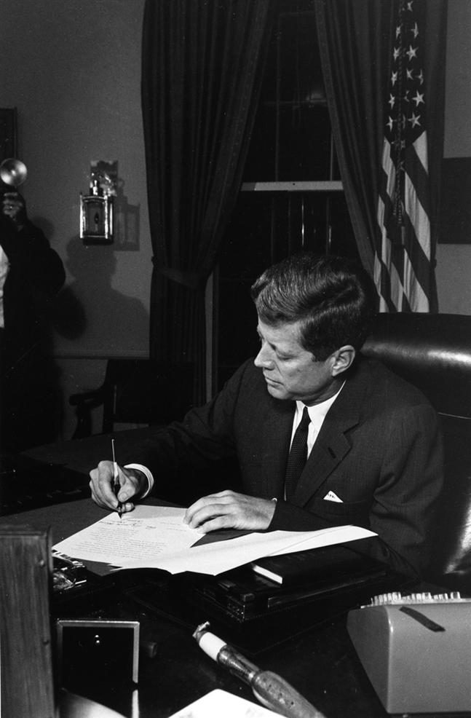
October 23, 1962: President Kennedy signs the bill to place a trade embargo on Cuba.
© Brain Wrinkles

Slide 27
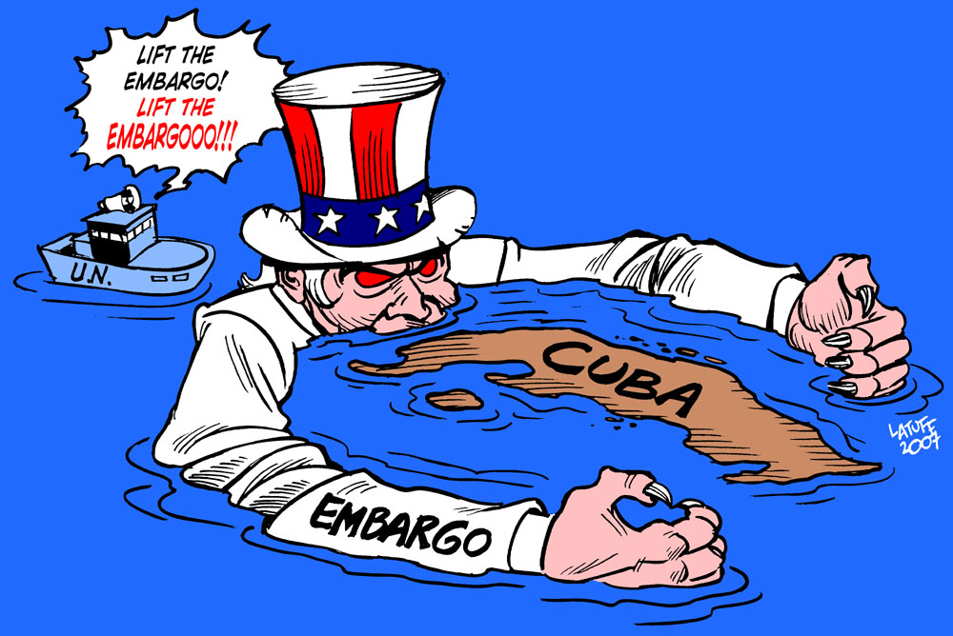
© Brain Wrinkles

Slide 28
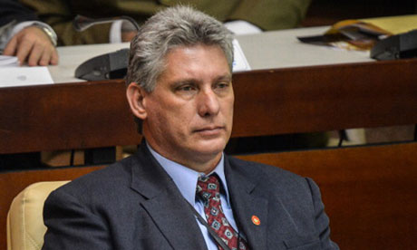
Today
Relations have not improved much over the past 50+ years.
There is still an embargo on goods to/from Cuba.
However, in 2015, the US government began to relax travel restrictions specifically for students and missionaries to Cuba.
Rumor has it….this guy is the next Cuban “President”!
Miguel
Diaz-Canel
© Brain Wrinkles

Slide 29
Immigrants
In the early 1980s and 1990s, there were periods in which large numbers of Cubans escaped the island for America.
Thousands of Cubans left because Castro would not allow free elections, freedom of speech, freedom of press, etc.
© Brain Wrinkles

Slide 30
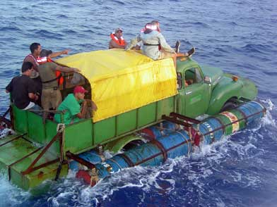
Cubans Escape to US
© Brain Wrinkles

Slide 31
Leadership
After a decline in health, Fidel Castro gave up the Cuban presidency on February 19, 2008.
His brother, Raul Castro, is now the Cuban dictator. He has announced his retirement date, 2018.
Most Cubans despise the Castro regime, but are too afraid to publicly oppose the government.
© Brain Wrinkles

Slide 32
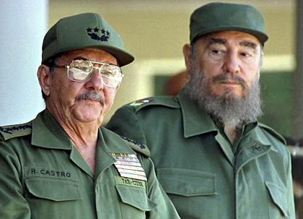
Raul and Fidel Castro
© Brain Wrinkles

