Slide 1
Essential Question: How is a federal-republican system different from a dictatorship?
Standard:
SS6CG2a. Compare the federal-republican systems of the Federative Republic of Brazil (Brazil) and the United Mexican States (Mexico) to the dictatorship of the Republic of Cuba (Cuba).

Slide 2
Governments of Latin America
Before we begin our studies of specific governments of Latin America, let’s review some important concepts.

Slide 3
Form of Leadership
Head of State:
Leader of a country who represents the state at official and ceremonial functions, but who may not be involved with the day-to-day activities of the government.
Head of Government:
A country’s top administrative leader who is designated to manage the day-to-day activities of the government.

Slide 4
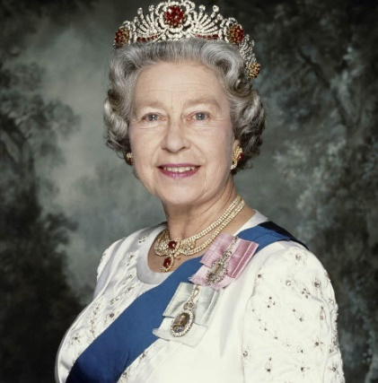
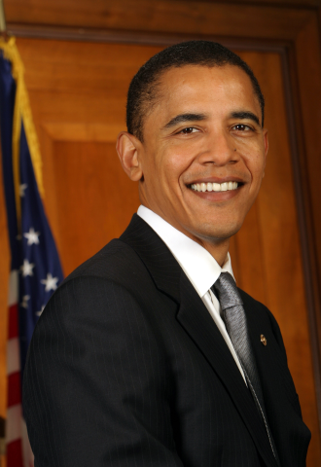
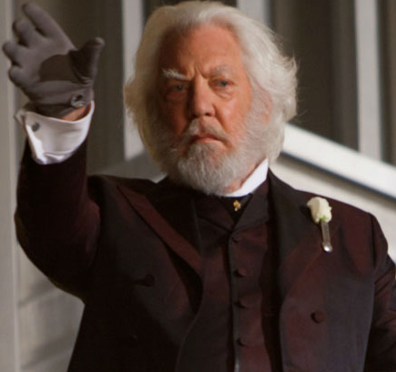
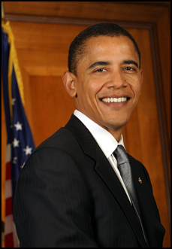
Form of Leadership
Head of State
Head of Government
Notes:
If you or your students are not familiar with The Hunger Games, just skip to pictures of the actors or ask a student who does know how these relate.

Slide 5
Governments of Latin America
What is the Legislature?
The Law making body of government. For the U.S., it is Congress [House of Representatives and the Senate].

Slide 6
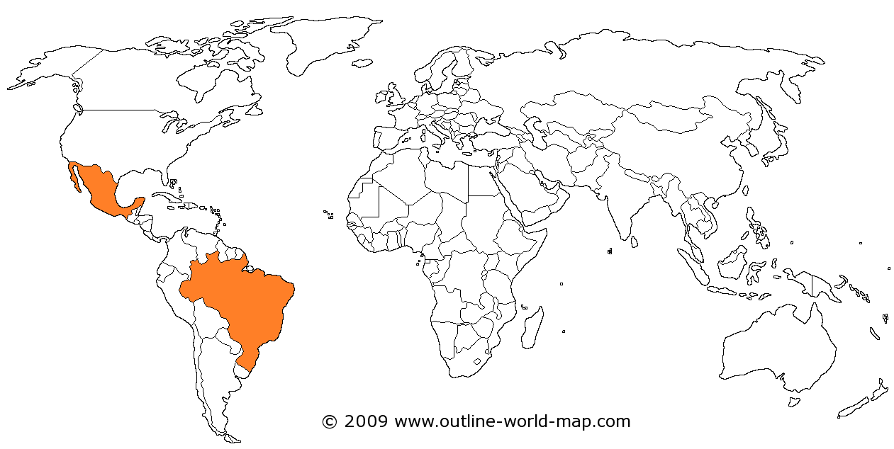
Governments of Latin America
Brazil and Mexico both have Presidential Democracies

Slide 7
Federative Republic of Brazil (Brazil)

Slide 8
Form of Leadership in Brazil
Brazil has a President who is both the head of state and head of government
The President is elected by
popular vote
The Bicameral National Congress (legislature with two houses) members are also elected.

Slide 9
Role of Citizens in Brazil
Citizens vote to elect both the President and the members of the Legislature
Voting is mandatory between the ages of 18-70 (voluntary between the ages of 16-18 and over 70).

Slide 10
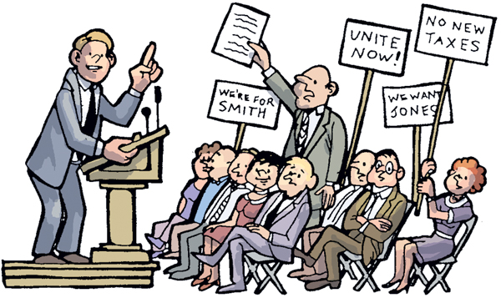

Personal Freedoms in Brazil
People can work where they want or
start a business [free trade and free enterprise].
Citizens enjoy personal freedoms like freedom of speech and freedom of assembly.

Slide 11
United Mexican States (Mexico)

Slide 12
Form of Leadership in Mexico
Mexico has a President who is both the head of state and head of government
The President is elected by
popular vote
The Bicameral National Congress (legislature with two houses) members are also elected.

Slide 13
Role of Citizens in Mexico
Citizens vote to elect both the President and the members of the Legislature
Voting is mandatory for citizens over the age of 18 (but it is not enforced)

Slide 14
Personal Freedoms in Mexico
People can work where they want or
start a business [free trade and free enterprise].
Citizens enjoy personal freedoms like freedom of speech and freedom of assembly.

Slide 15
Republic of Cuba (Cuba)

Slide 16
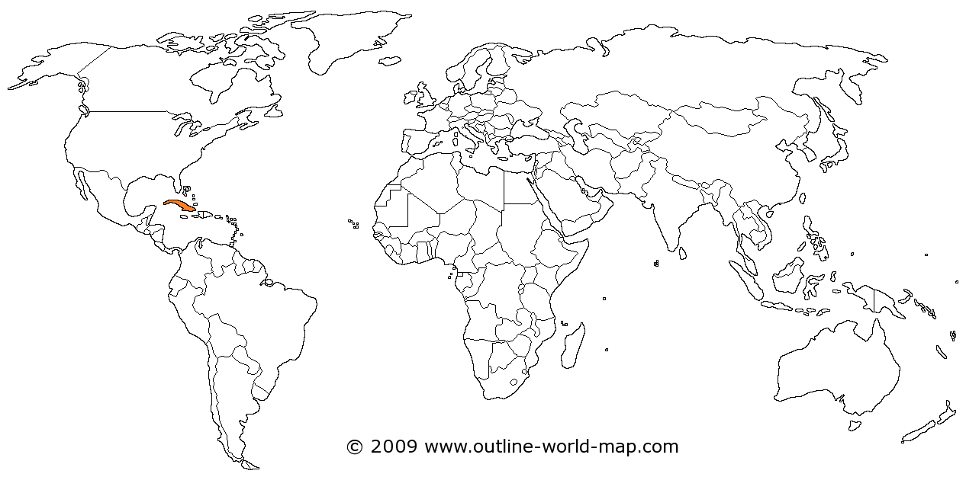
Governments of Latin America
Cuba is a dictatorship in which the ruler has absolute power (not restricted by a constitution of laws). It is an autocracy!

Slide 17
Form of Leadership in Cuba
Cuba says they hold elections but they are rigged
Cuba has a President who is both the chief of state and head of government.
The President (dictator) is technically elected by the Unicameral National Assembly (legislature with one house). The last election was held in 2008.

Slide 18
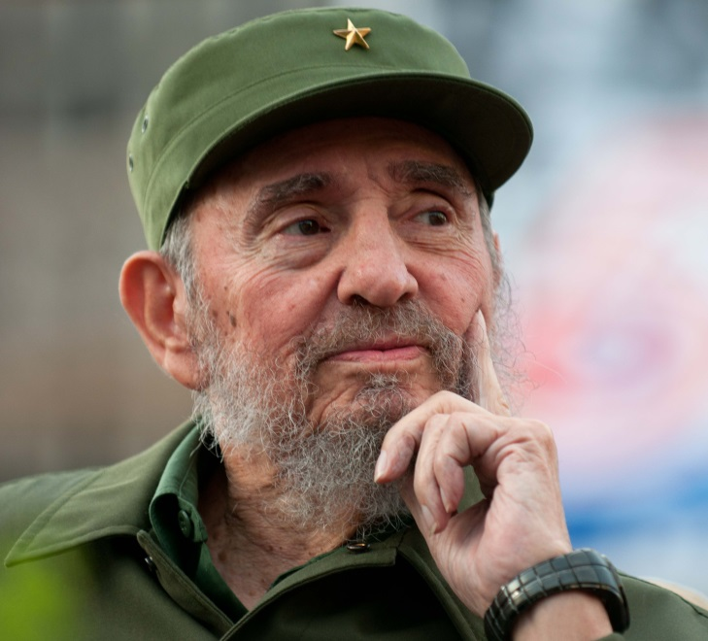
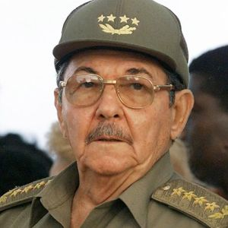
Form of Leadership in Cuba
Fidel Castro ruled Cuba from 1959 to 2008. When he stepped down his brother Raul became ruler. Raul passed the power to Miguel Díaz-Canel in 2019.

Slide 19
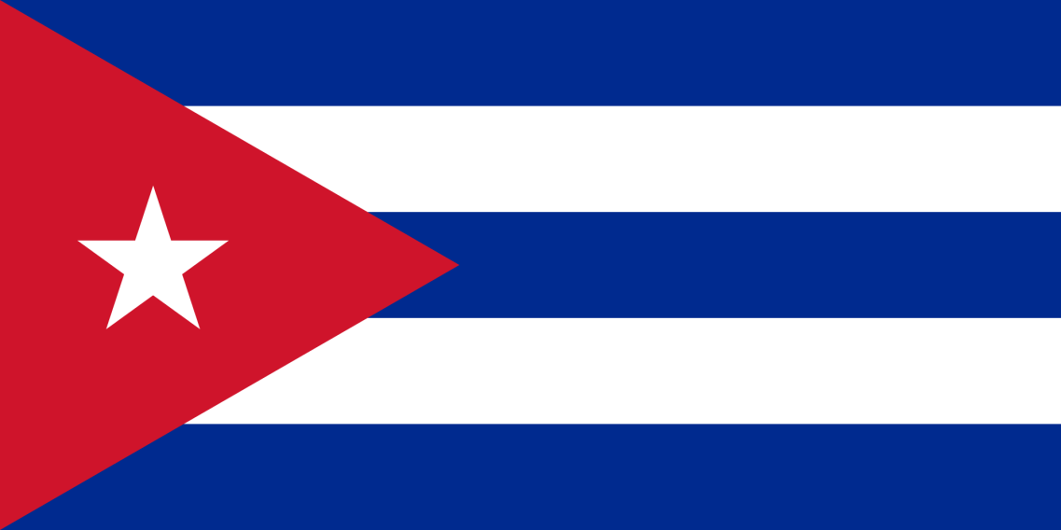
Form of Leadership in Cuba
Cuba’s official name is the Republic of Cuba. Why is
this misleading?

Slide 20
Form of Leadership in Cuba
The members of the Legislature are those officially sanctioned (approved) by Cuba’s Communist Party. They run for office unopposed ( no one runs against them)

Slide 21
Role of Citizens in Cuba
Citizens can “vote” at the age of 16 for members of the Legislature.
However, citizens can only vote for candidates selected by the Communist Party.

Slide 22
Personal Freedoms in Cuba
Cuba’s citizens do not have personal freedoms like freedom of speech.
They can be put in jail for criticizing the Communist Party or the president.
People cannot just work where they want to work or open their own business.

Slide 23
Think about…how has Cuba’s current government contradicted the purpose of the Cuban Revolution???

Slide 24
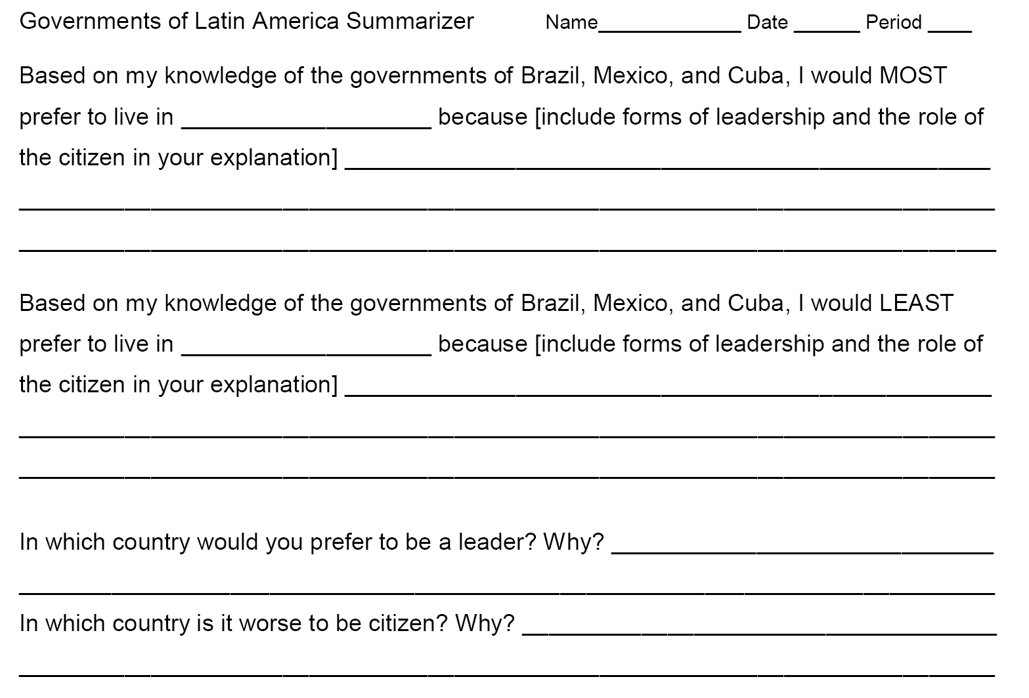
Use this summarizer/ fill in the blank to summarize your government understanding

Slide 25
Access to forms for summary
Forms link click HERE ☺

